Slide 1

Should Questions be a single class or multiple classes, with specific classes for each type of question (i.e. short answer, true / false, essay, multiple choice, matching, and ranking)?
One class to handle all questions.
More than one class to handle the different types of questions.
SE 310 - Software Design - Drexel University

Slide 2

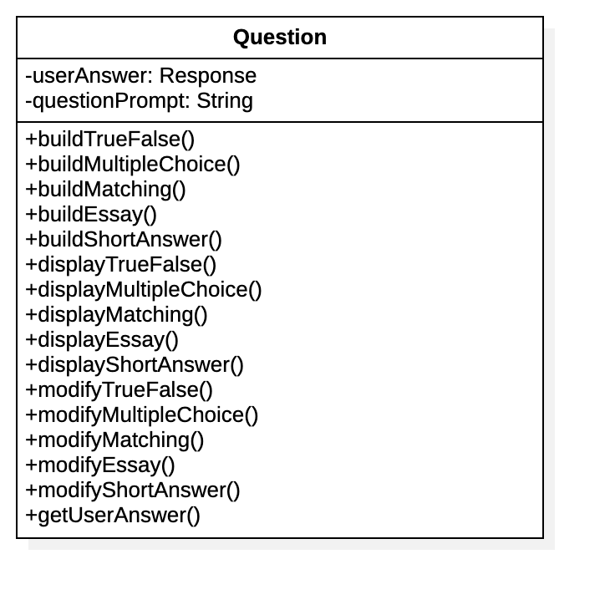
Having all the questions combined in one class creates undue coupling and makes the design difficult to maintain.
What happens when a new question class is added?
What happens if all the question classes aren’t needed?
Return to the previous question
SE 310 - Software Design - Drexel University

Slide 3

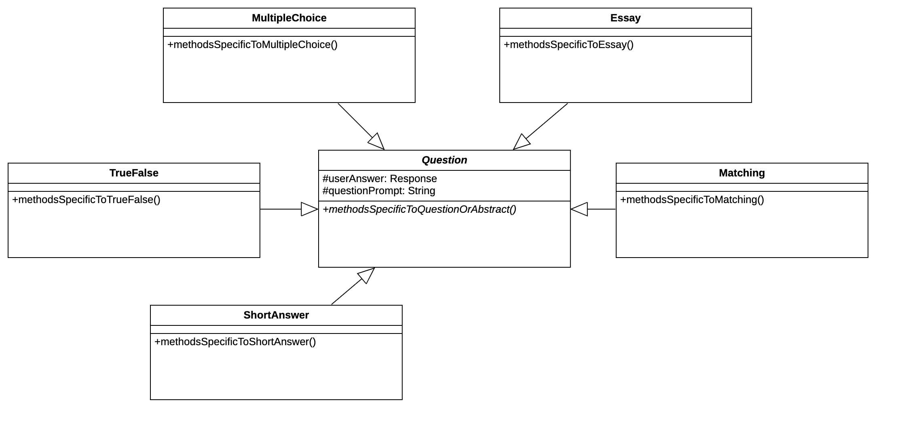
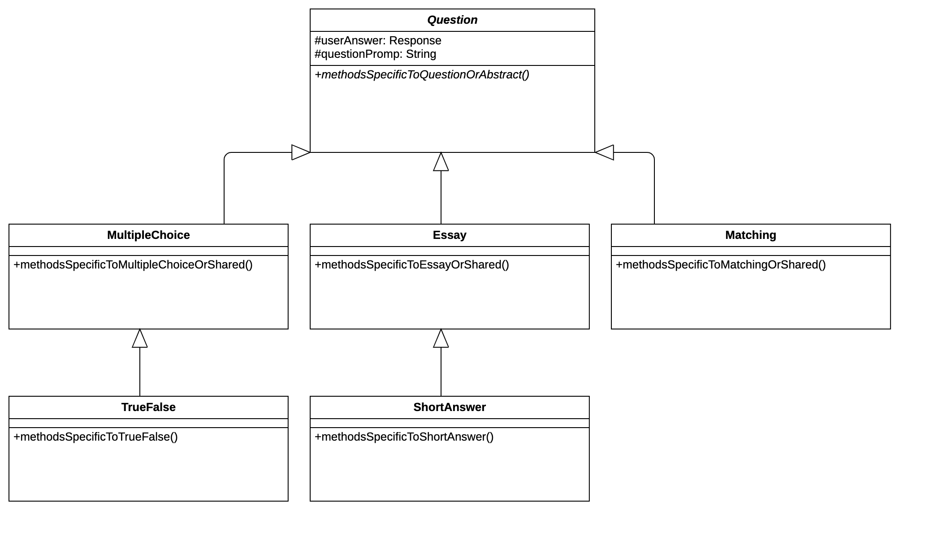
Which design using multiple question classes is better?
SE 310 - Software Design - Drexel University

Slide 4
While having multiple questions classes is better than a single question class, not having any of the subclasses of the Question class inherit from each other doesn’t allow for maximum reuse.
Return to the previous question
SE 310 - Software Design - Drexel University

Slide 5

Success, there are many ways question classes can be arranged.
This is merely one of them.
There should be some reuse from one question class to another.
It’s certainly debatable what the best mix is.
There can even be other abstract classes added to the design.
SE 310 - Software Design - Drexel University

